Slide 1
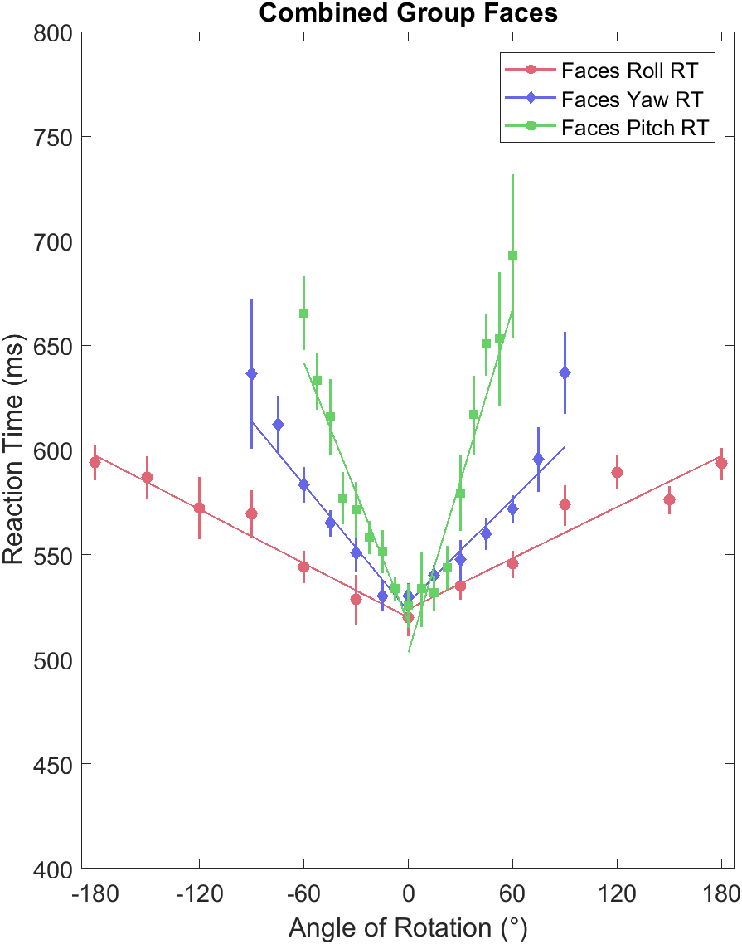
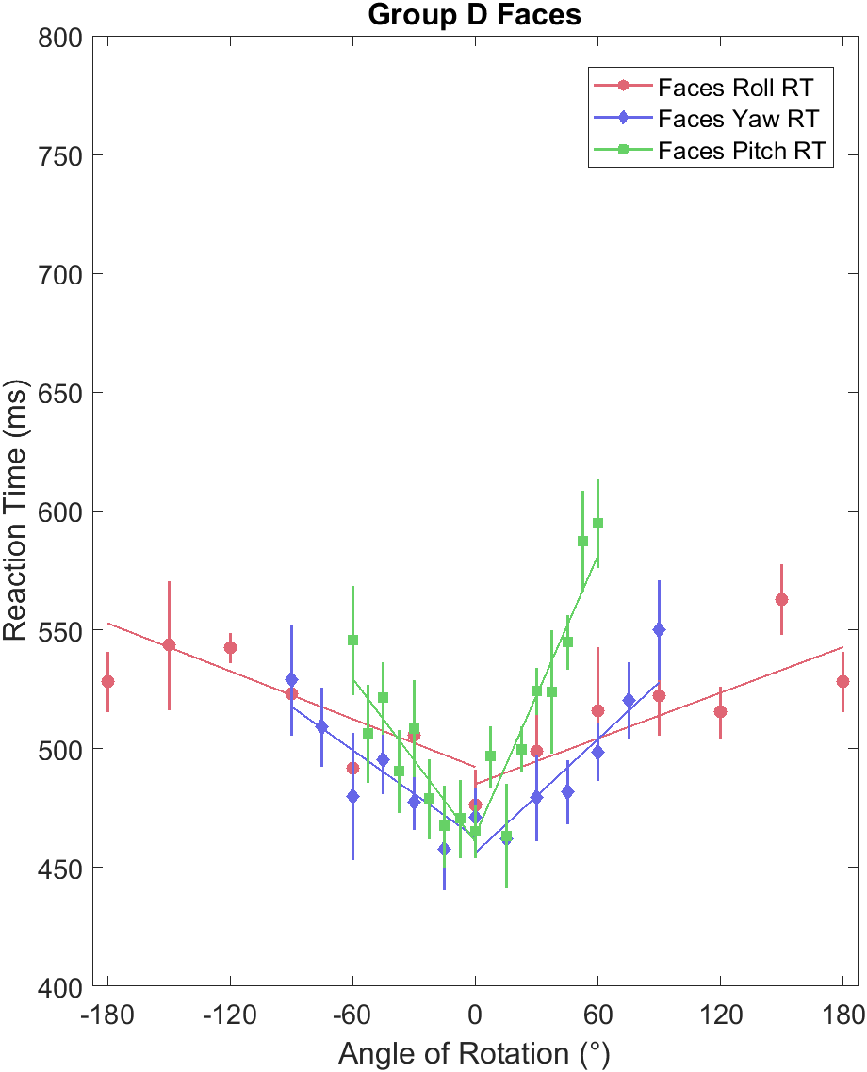
Unfamiliar Faces Familiar Faces

Slide 2
Experiment Information |  |  | Negative (Counterclockwise, Left, Down) |  |  |  | Positive (Clockwise, Right, Up)
Protocol | n |  | Slope (ms/°) | Intercept (ms) | R | Reduced X² | Slope (ms/°) | Intercept (ms) | R | Reduced X²
Face Roll | 56 |  | -0.43 | 521 | -0.99 | 0.25 | 0.40 | 525 | 0.94 | 1.68
- familiar | 6 |  | -0.44 | 485 | -0.93 | 1.37 | 0.32 | 484 | 0.82 | 1.21
Face Yaw | 56 |  | -1.01 | 522 | -0.98 | 0.81 | 0.84 | 526 | 0.95 | 1.02
- familiar | 6 |  | -0.61 | 462 | -0.88 | 0.43 | 0.80 | 456 | 0.93 | 0.76
Face Pitch | 54 |  | -2.07 | 517 | -0.97 | 0.85 | 2.73 | 503 | 0.97 | 2.14
- familiar | 6 |  | -1.14 | 461 | -0.82 | -0.91 | 1.96 | 464 | 0.94 | 0.96

